Slide 1
Predicting Disease in Chest X-rays
Ravi Mehta

Slide 2
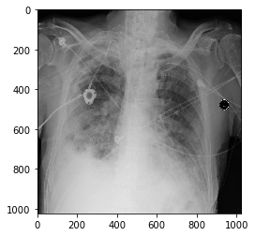
Overview
Medical Imaging is incredibly important in diagnosis disease
Chest X-rays are one of the most ubiquitous imaging procedures
Goal: Make a machine read a Chest X-ray and predict if disease was present

Slide 3
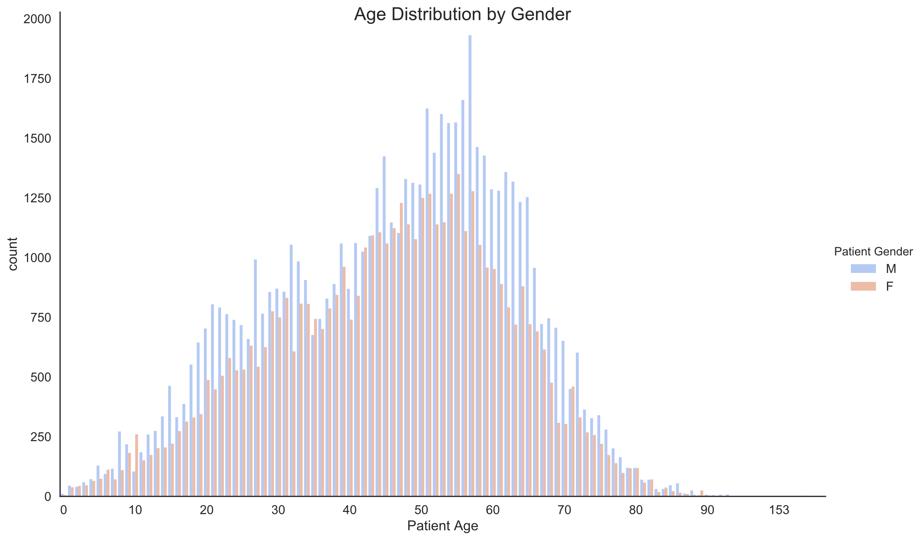

Slide 4
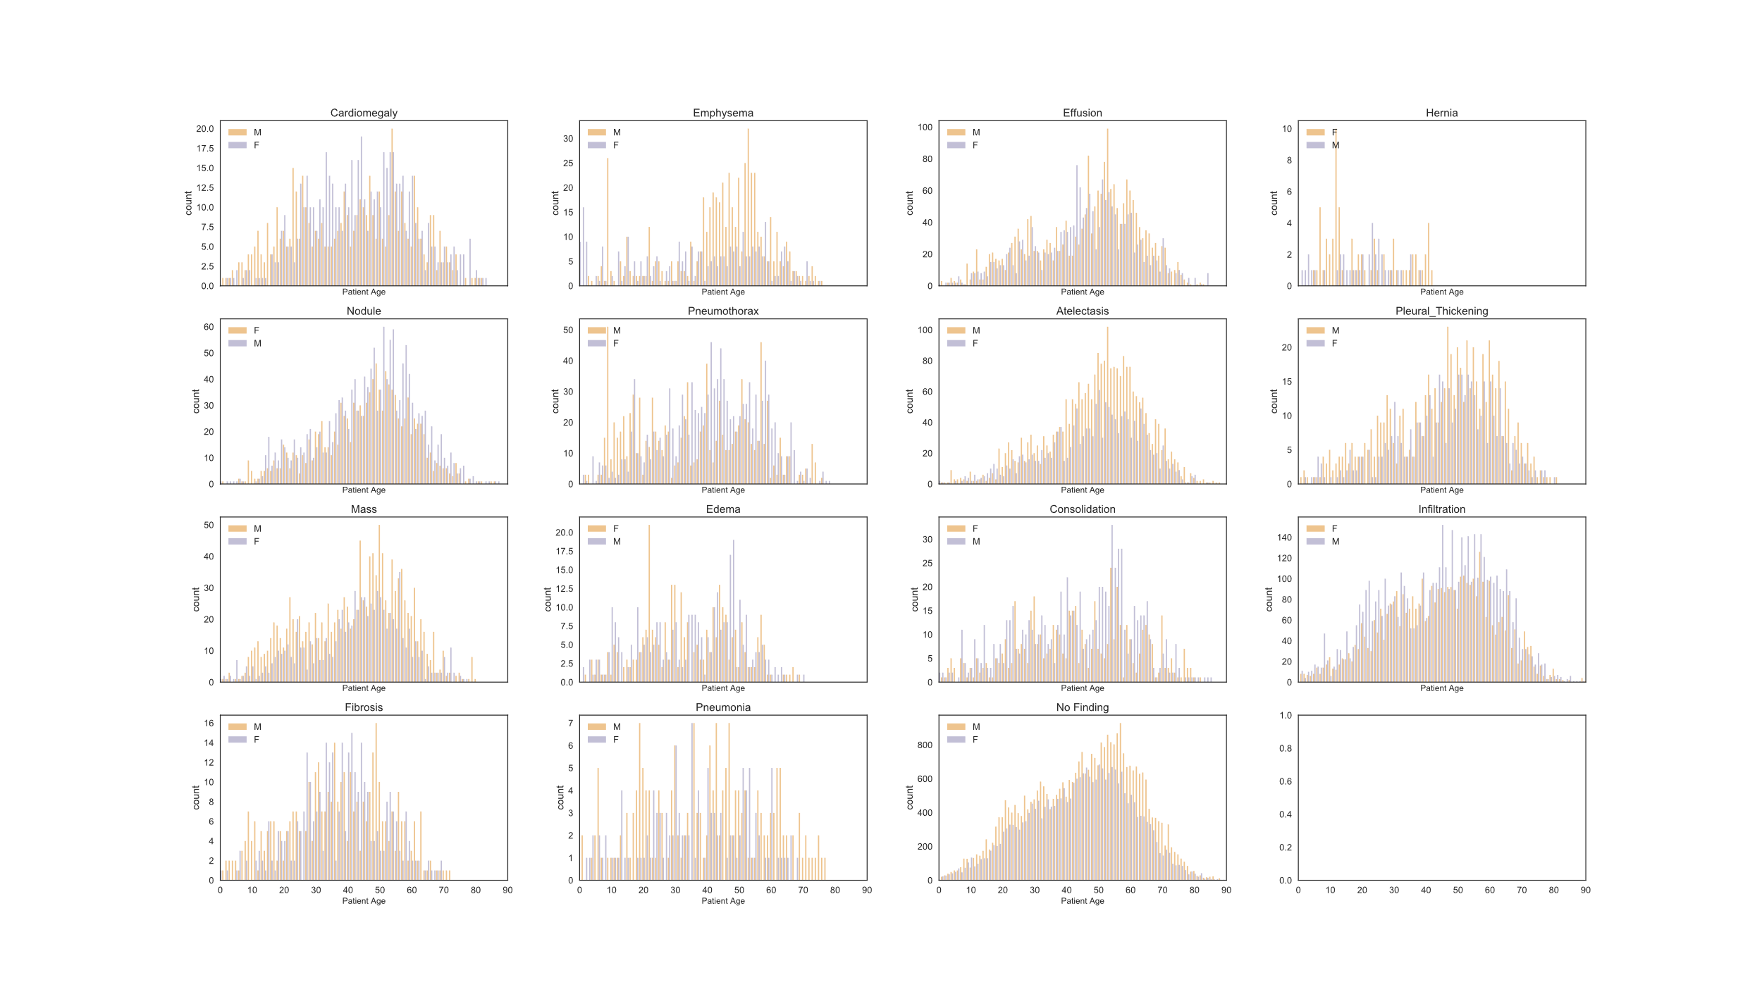

Slide 5
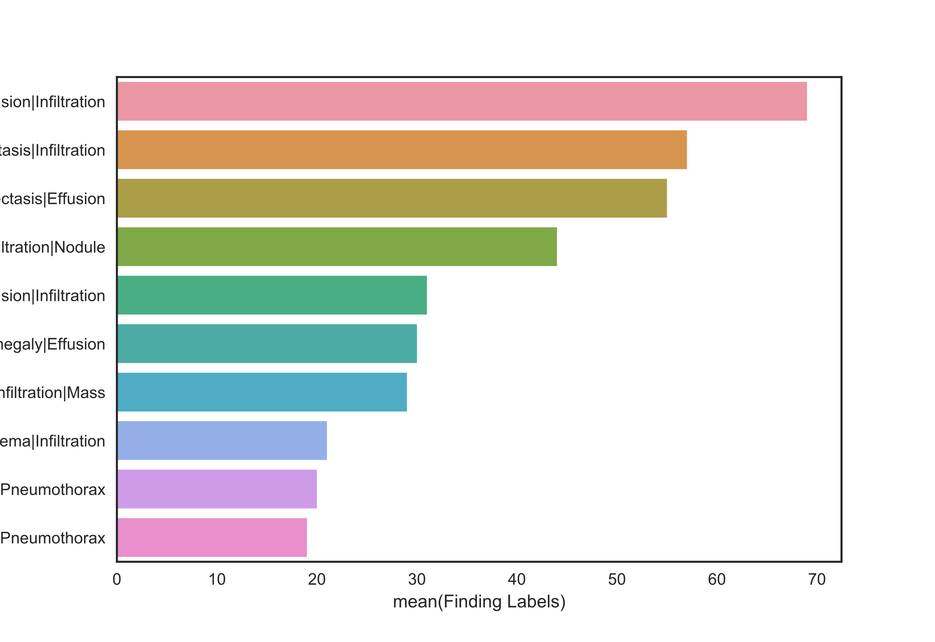
Most Common Pathologies
Effusion | Infiltration
Atelectasis | Infiltration
Atelectasis | Effusion
Infiltration | Nodule
Atelectasis | Effusion | Infiltration
Cardiomegaly | Effusion
Infiltration | Mass
Edema | Infiltration
Effusion |Pneumothorax
Infiltration|Pneumothorax
Disease Count

Slide 6
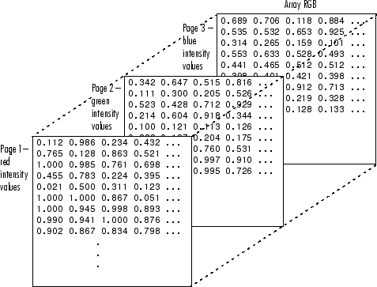
Image to Matrix

Slide 7
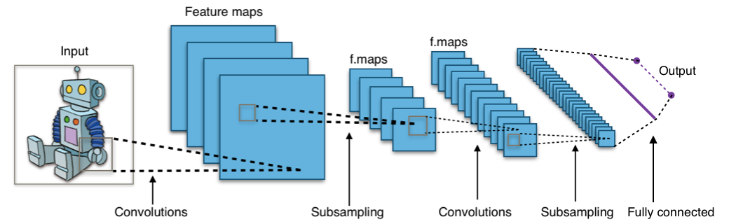
Simple Convolutional Neural Network

Slide 8
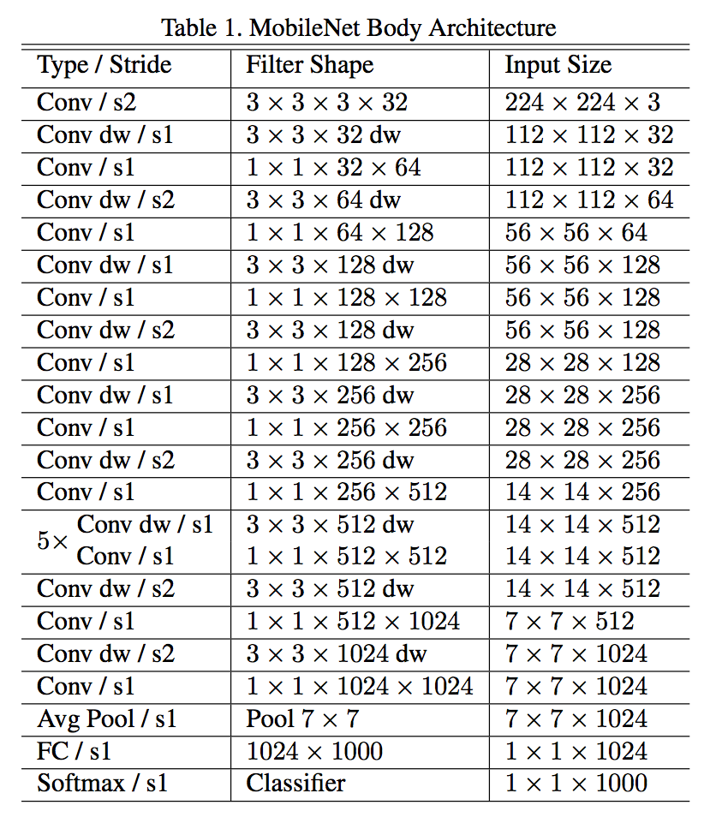
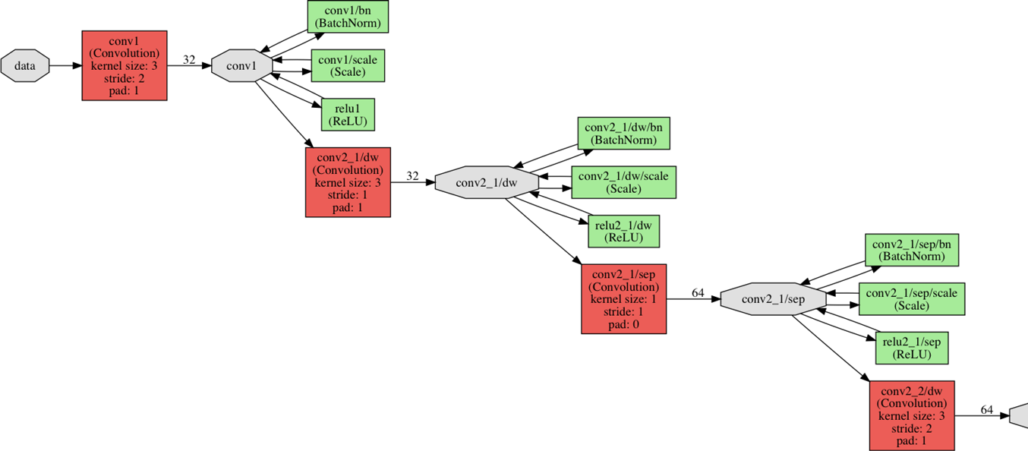
MobileNet Topology

Slide 9
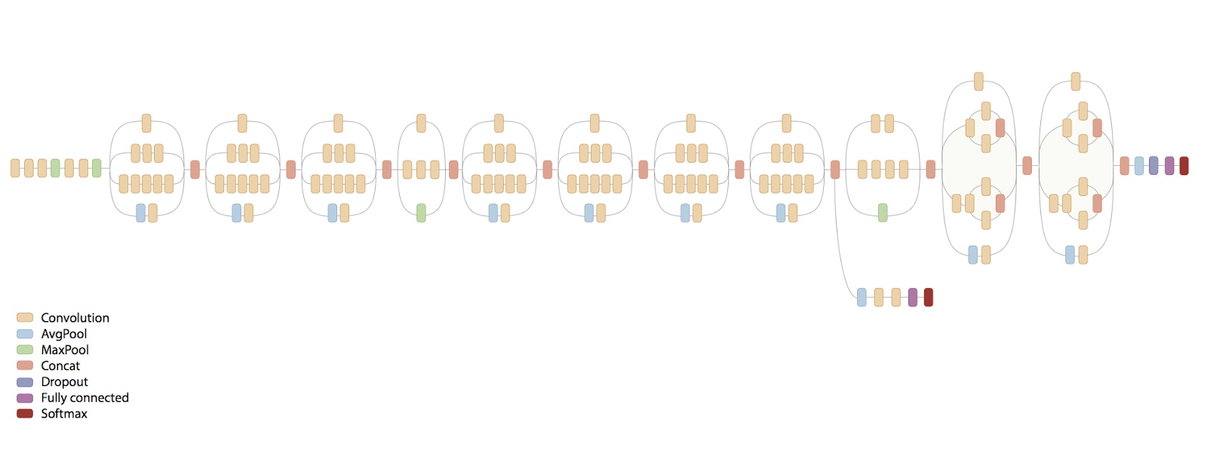
InceptionV3 Topology

Slide 10
MobileNet 128 X 128 X 1
MobileNet
256 x 256 x 3
InceptionV3
256 x 256 x 1
 | No Findings | Abnormal Findings
No Findings | 0.55 | 0.45
Abnormal Findings | 0.43 | .057
 | No Findings | Abnormal Findings
No Findings | 0.61 | 0.39
Abnormal Findings | 0.44 | 0.56
 | No Findings | Abnormal Findings
No Findings | 0.69 | 0.31
Abnormal Findings | 0.45 | 0.55

Slide 11
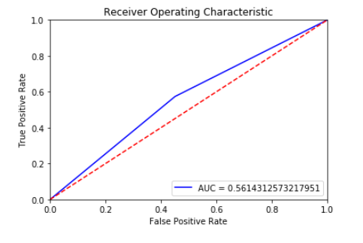
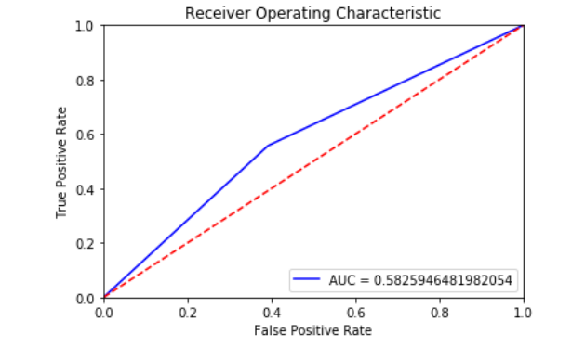
ROC AUC Curves for MobileNet

Slide 12
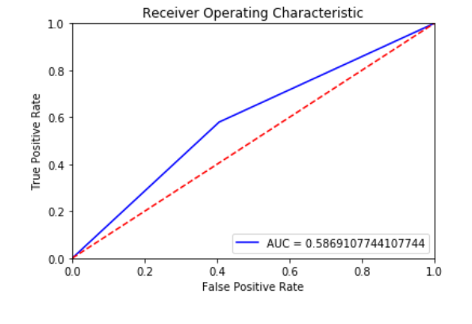
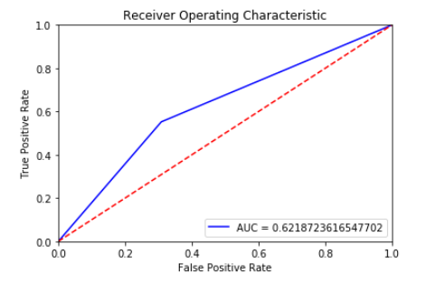
ROC AUC Curves for InceptionV3

Slide 13
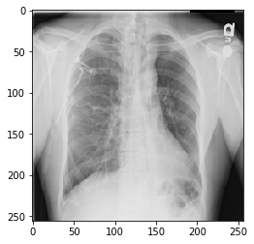
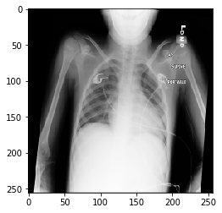
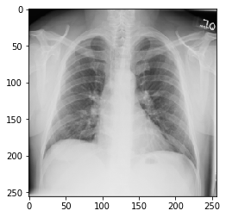



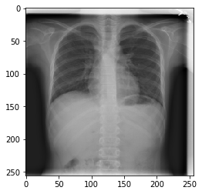
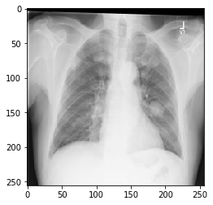
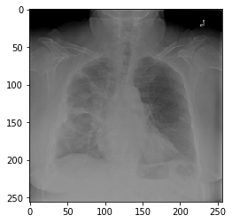


Slide 14
Future Considerations
Try other CNN topologies published in Literature
Latest research is showing very deep CNNs perform very well at image recognition
Dense121 is an very deep CNN
Try to detect individual pathologies

